Slide 1
Ansible and Ansible Tower
Jim Garrett
Senior Solution Architect
jgarrett@redhat.com
November 2018

Slide 2
What You Will Learn
What is Ansible and The Ansible Way
How Ansible Works and its Key Components
Ad-Hoc Commands
Playbook Basics
Reuse and Redistribution of Ansible Content with Roles
Ansible Tower

Slide 3

WHAT IS ANSIBLE?
Automation Engine
IT Infrastructure
Networks - F5, Arista, Cisco,
Juniper, Open Vswitch
VYOS, others

Slide 4
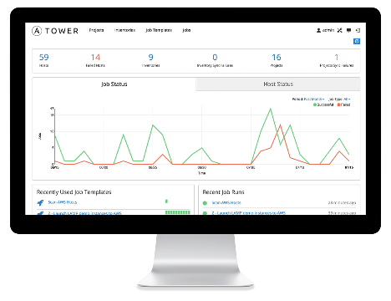
WHAT IS ANSIBLE?
It’s an automation engine - Ansible
Automate What????

Slide 5
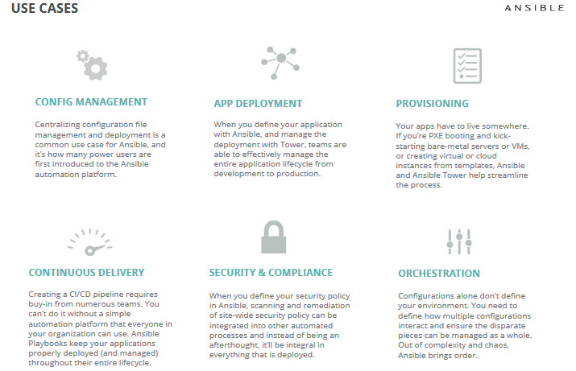

Slide 6
WHAT IS ANSIBLE?
It’s an automation engine - Ansible
It’s an automation language - Ansible Playbooks.
Enterprise framework for controlling, securing and managing your automation – Ansible Tower

Slide 7
SIMPLE
POWERFUL
Agentless
Human readable automation
No special coding skills needed
Tasks executed in order
Get productive quickly
Configuration management
App deployment
Workflow orchestration
Orchestrate the app lifecycle
Agentless architecture
Uses OpenSSH & WinRM
More efficient & more secure

Slide 8
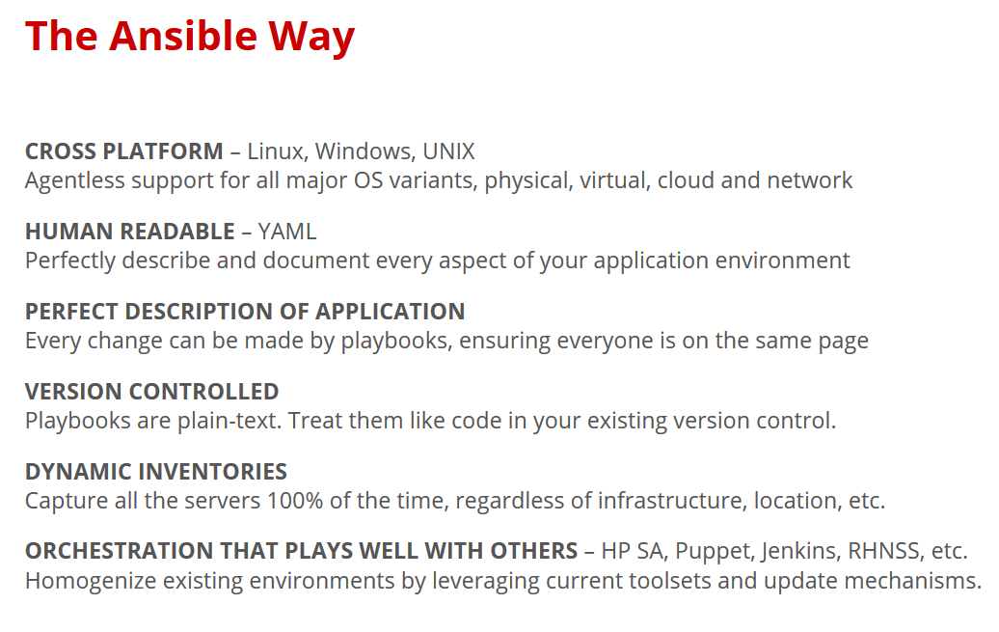

Slide 9
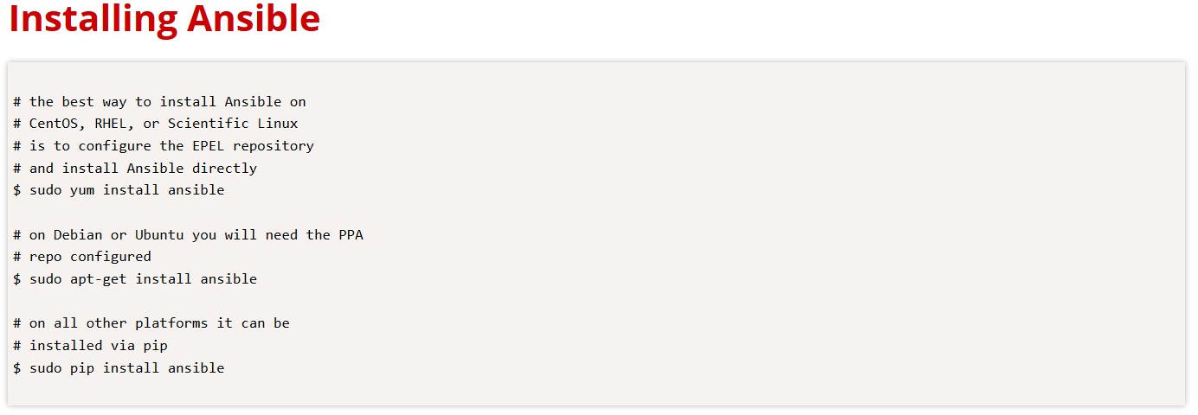

Slide 10
Lab Location
https://github.com/jimgarrett123/ansible-workshop

Slide 11
Lab 1 : Ansible_Install

Slide 12
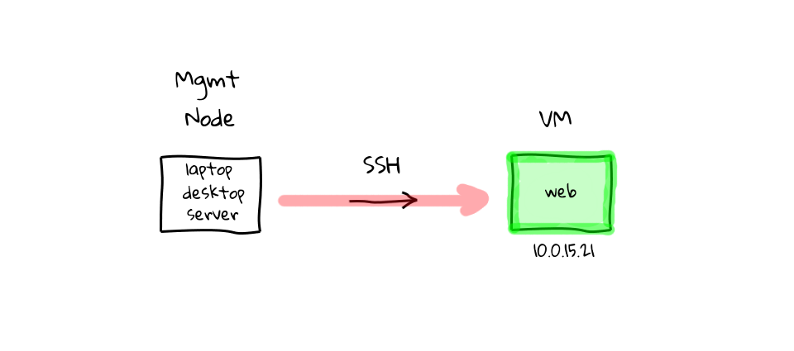
How ANSIBLE Works – Simplicity – Command Line
$ ansible all -m ping

Slide 13
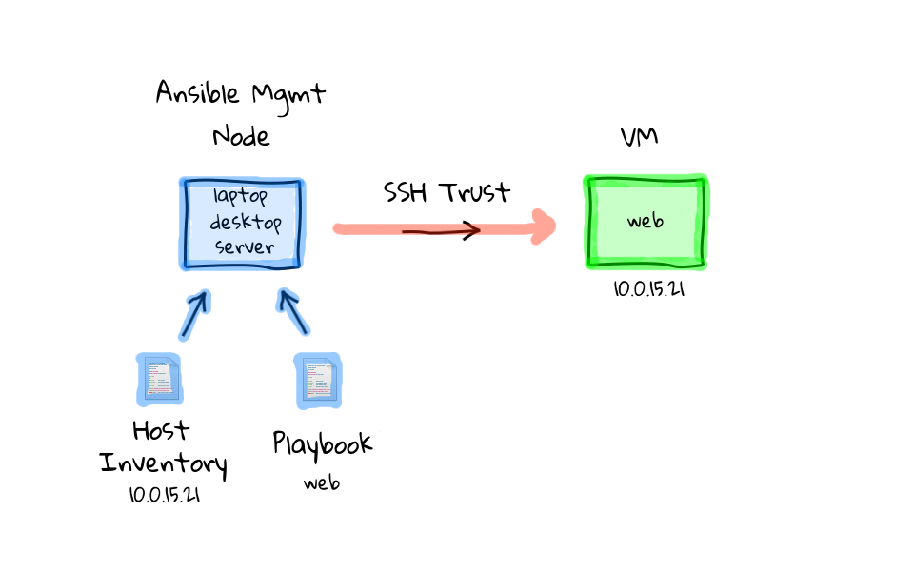
How ANSIBLE Works – Simplicity - playbook
$ ansible-playbook simple_playbook.yml

Slide 14
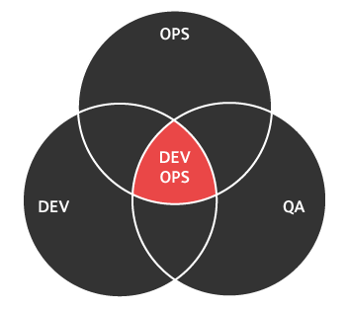
How ANSIBLE Works – Inventory file example
[web] r2d2.example.com c3po.example.com
[dbservers] mysql.example.com postgre.example.com

Slide 15

How ANSIBLE Works – Playbook
---
- name: install and start apache
hosts: web
vars:
http_port: 80
max_clients: 200
remote_user: root
tasks:
- name: install httpd
yum: pkg=httpd state=latest
- name: write the apache config file
template: src=/srv/httpd.j2 dest=/etc/httpd.conf
- name: start httpd
service: name=httpd state=running

Slide 16
How ANSIBLE Works – Playbook - hosts
---
- name: install and start apache
hosts: web
vars:
http_port: 80
max_clients: 200
remote_user: root
tasks:
- name: install httpd
yum: pkg=httpd state=latest
- name: write the apache config file
template: src=/srv/httpd.j2 dest=/etc/httpd.conf
- name: start httpd
service: name=httpd state=running

Slide 17
How ANSIBLE Works – Playbook - Variables
---
- name: install and start apache
hosts: web
vars:
http_port: 80
max_clients: 200
remote_user: root
tasks:
- name: install httpd
yum: pkg=httpd state=latest
- name: write the apache config file
template: src=/srv/httpd.j2 dest=/etc/httpd.conf
- name: start httpd
service: name=httpd state=running

Slide 18
How ANSIBLE Works – Playbook – remote user
---
- name: install and start apache
hosts: web
vars:
http_port: 80
max_clients: 200
remote_user: root
tasks:
- name: install httpd
yum: pkg=httpd state=latest
- name: write the apache config file
template: src=/srv/httpd.j2 dest=/etc/httpd.conf
- name: start httpd
service: name=httpd state=running

Slide 19
How ANSIBLE Works – Playbook - Tasks
---
- name: install and start apache
hosts: web
vars:
http_port: 80
max_clients: 200
remote_user: root
tasks:
- name: install httpd
yum: pkg=httpd state=latest
- name: write the apache config file
template: src=/srv/httpd.j2 dest=/etc/httpd.conf
- name: start httpd
service: name=httpd state=running

Slide 20
How ANSIBLE Works – Playbook - Tasks
---
- name: install and start apache
hosts: web
vars:
http_port: 80
max_clients: 200
remote_user: root
tasks:
- name: install httpd
yum: pkg=httpd state=latest
- name: write the apache config file
template: src=/srv/httpd.j2 dest=/etc/httpd.conf
- name: start httpd
service: name=httpd state=running

Slide 21
How ANSIBLE Works – Playbook - Tasks
---
- name: install and start apache
hosts: web
vars:
http_port: 80
max_clients: 200
remote_user: root
tasks:
- name: install httpd
yum: pkg=httpd state=latest
- name: write the apache config file
template: src=/srv/httpd.j2 dest=/etc/httpd.conf
- name: start httpd
service: name=httpd state=running

Slide 22
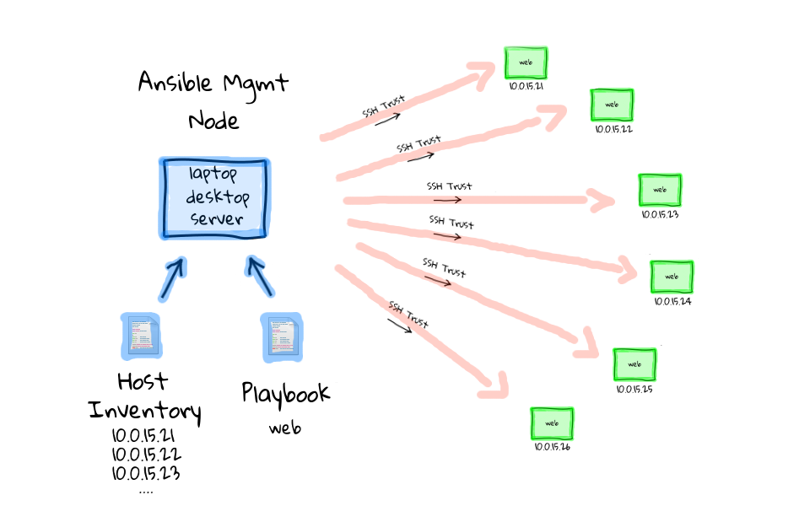
How ANSIBLE Works – at scale
$ ansible-playbook simple_playbook.yml

Slide 23
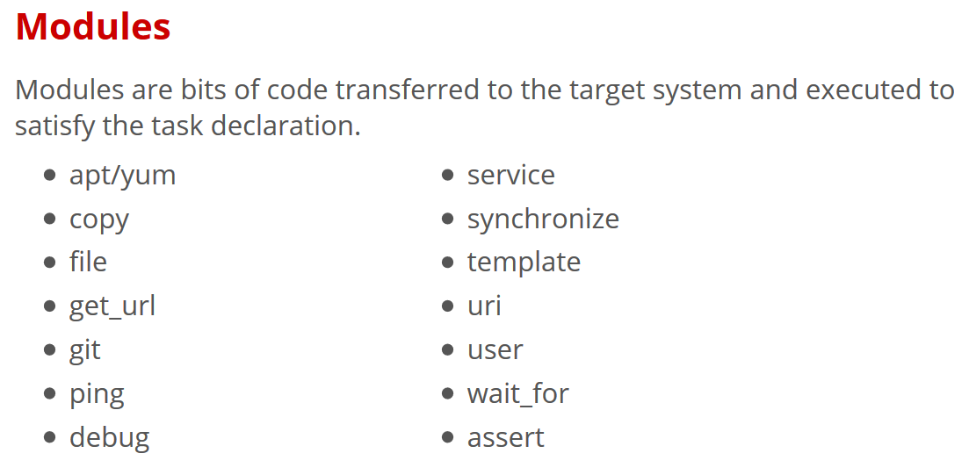
$ ansible all -m ping

Slide 24
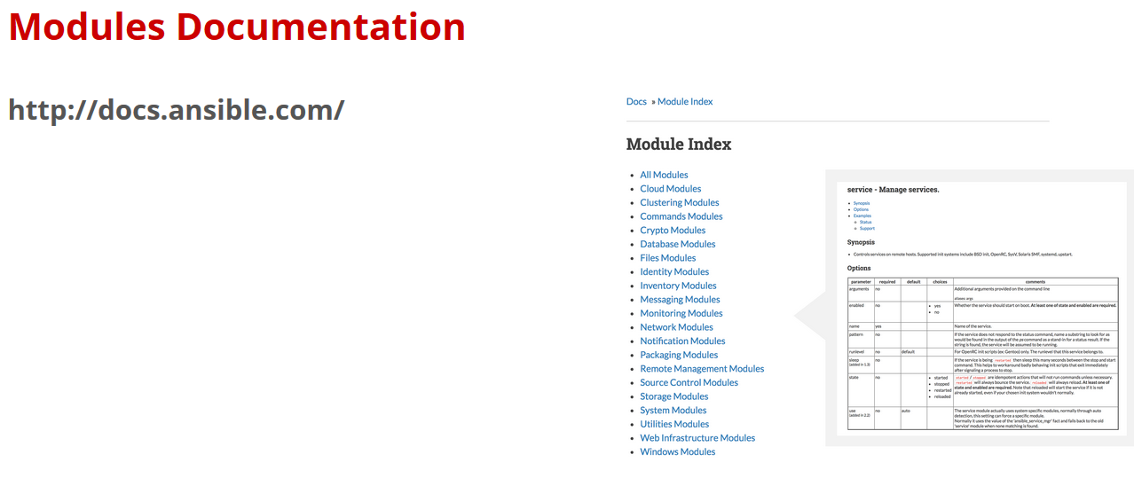

Slide 25
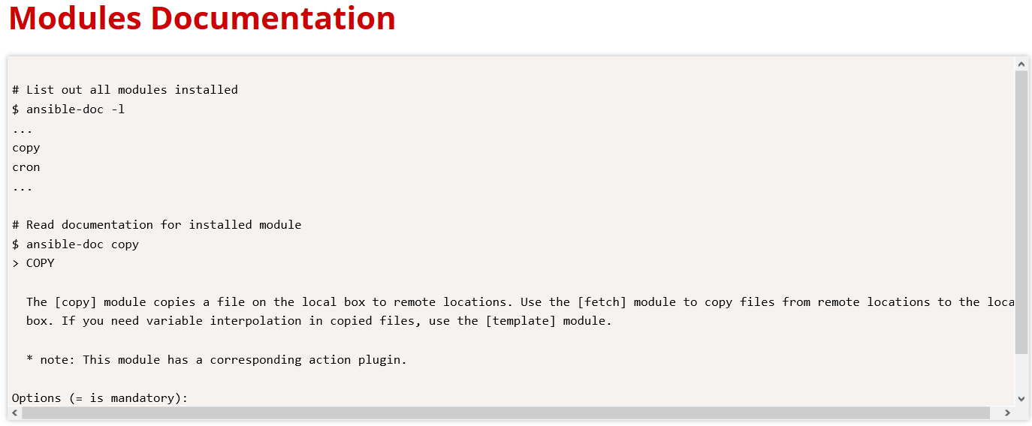

Slide 26
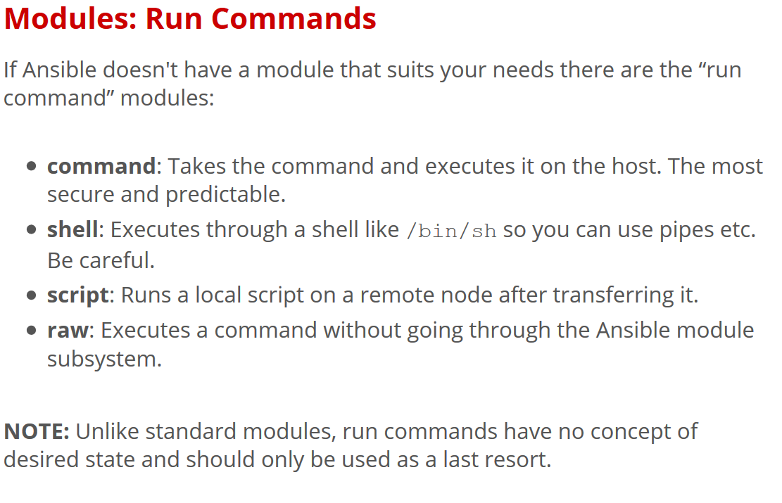

Slide 27
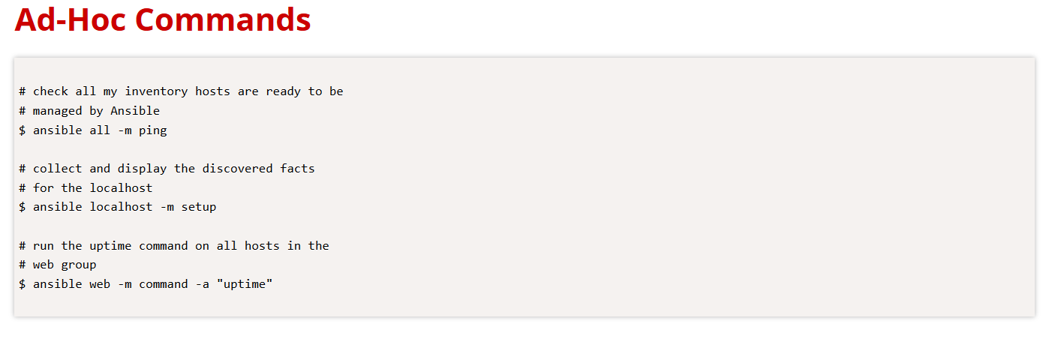

Slide 28
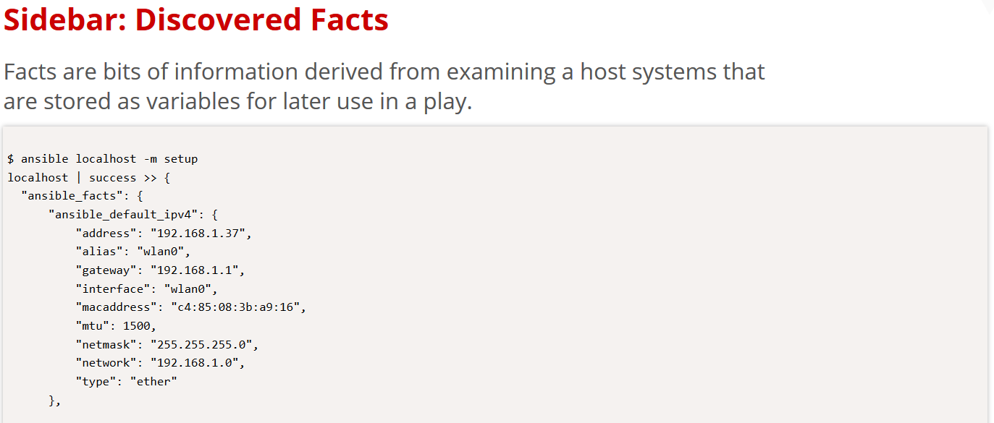

Slide 29
Lab 2 :Adhoc_Commands

Slide 30
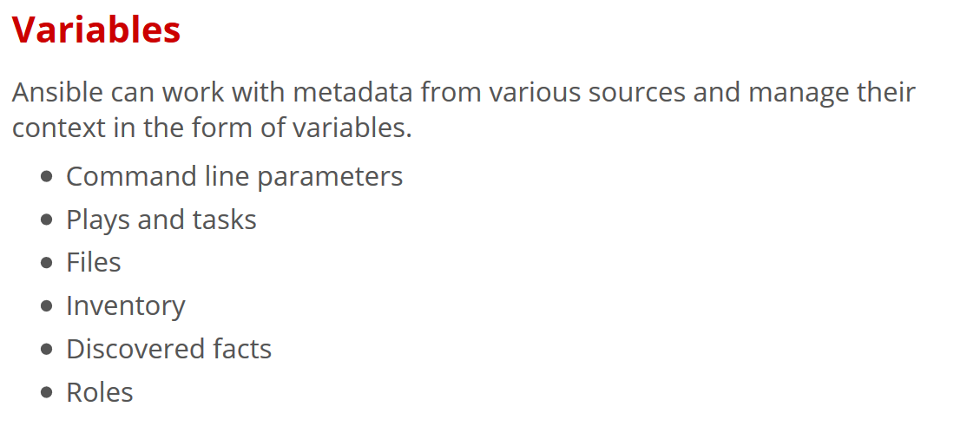

Slide 31
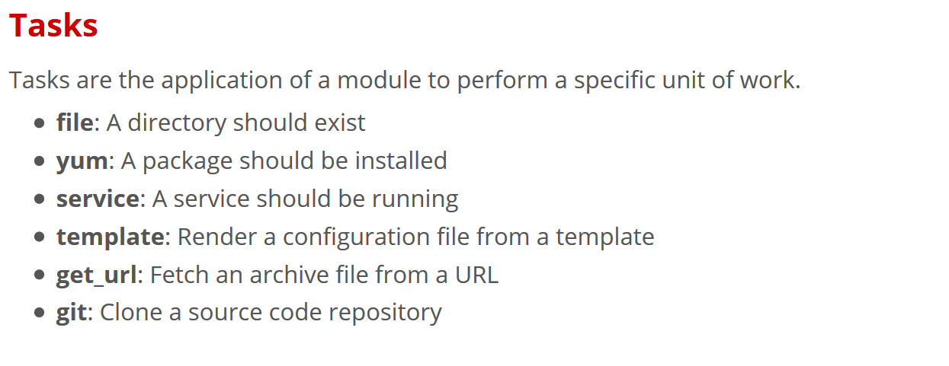

Slide 32
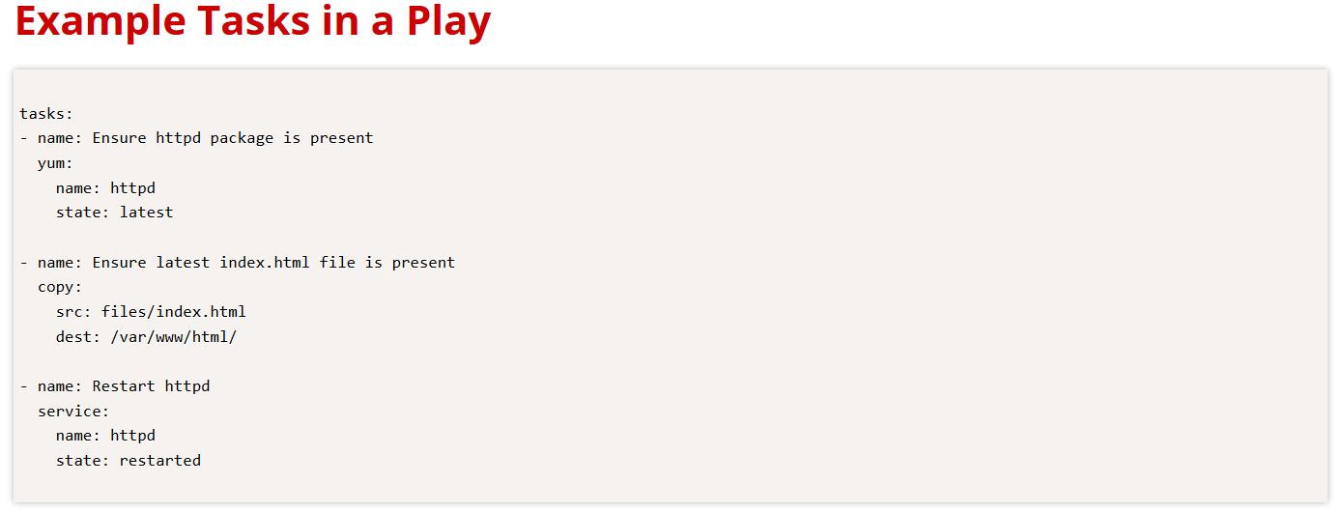

Slide 33
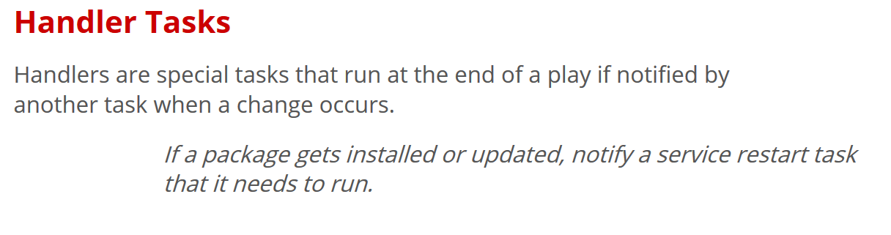

Slide 34
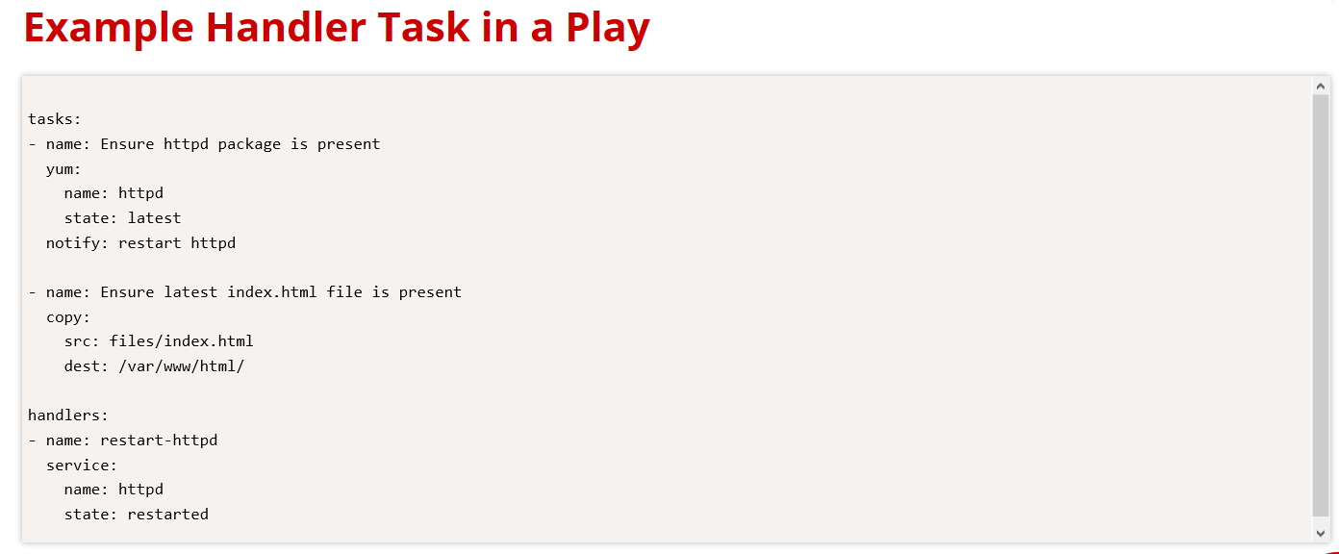

Slide 35
Lab 3 : Simple_Playbook (nginx)

Slide 36
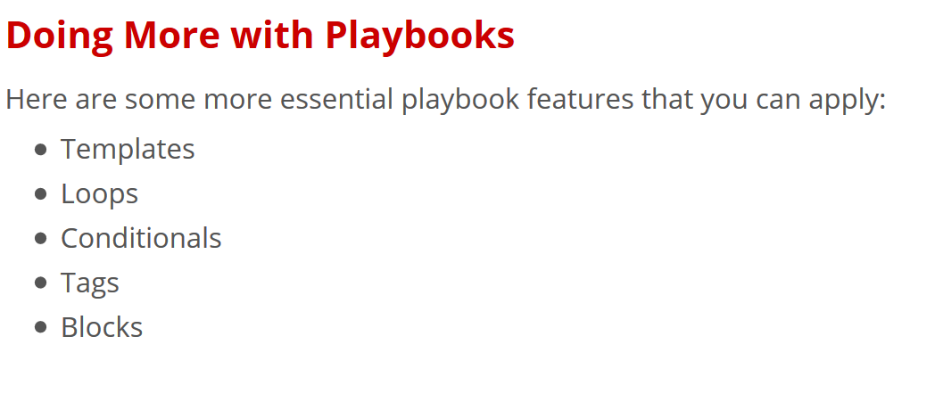

Slide 37
Lab 4 : Basic_Playbook (a more practical playbook)

Slide 38
Roles
Roles are a packages of closely related Ansible content that can be shared more easily than plays alone.
Improves readability and maintainability of complex plays
Eases sharing, reuse and standardization of automation processes
Enables Ansible content to exist independently of playbooks, projects -- even organizations
Provides functional conveniences such as file path resolution and default values

Slide 39
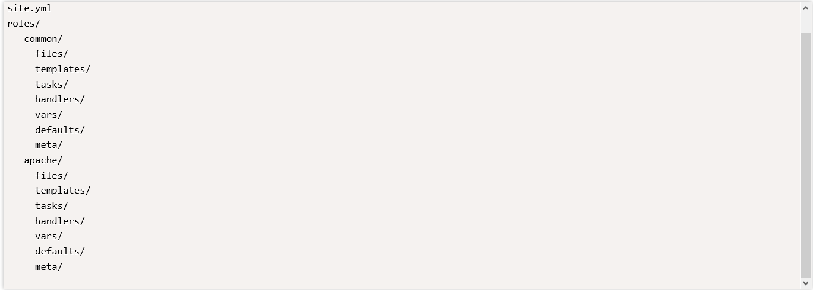
Project with Embedded Roles Example

Slide 40
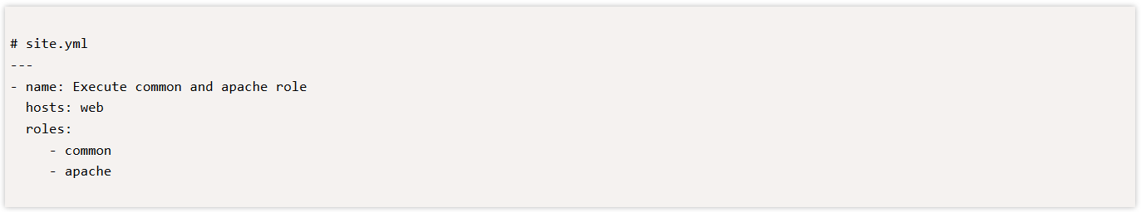
Project with Embedded Roles Example

Slide 41
Lab 5 : Roles

Slide 42
Next Steps
It's easy to get started ansible.com/get-started
Join the Ansible community ansible.com/community
Would you like to learn a lot more? redhat.com/en/services/training/do407-automation-ansible

Slide 43
Introduction to Ansible Tower

Slide 44
What You Will Learn
What is Ansible Tower
How Ansible Tower Works
Installing Ansible Tower
Key Features

Slide 45
What is Ansible Tower?
Ansible Tower is an enterprise framework for controlling, securing and managing your Ansible automation – with a UI and RESTful API
Role-based access control keeps environments secure, and teams efficient
Non-privileged users can safely deploy entire applications with push-button deployment access
All Ansible automations are centrally logged, ensuring complete auditability and compliance

Slide 46
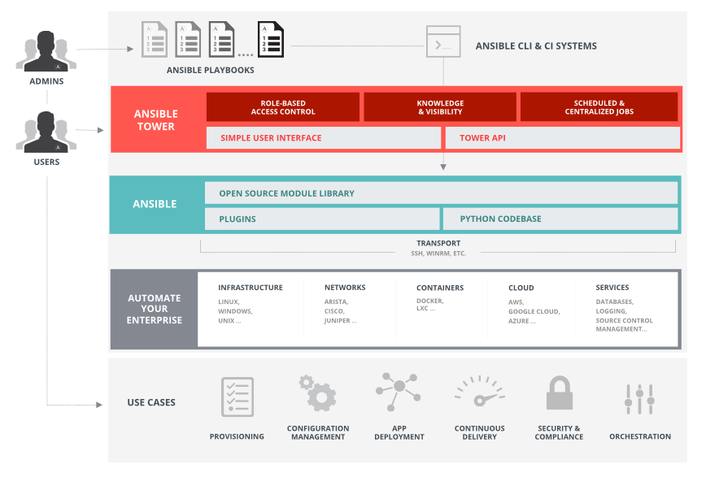
Platform Overview

Slide 47
Installing Ansible Tower
Download the latest Ansible Tower package
$ curl -O https://releases.ansible.com/ansible-tower/setup-bundle/ansible-tower-setup-bundle-latest.el7.tar.gz
Untar and unzip the package file
$ tar xvfz /tmp/ansible-tower-setup- (Name of tar file that was downloaded)*
Change directories into the ansible tower package
$ cd /tmp/ansible-tower-setup
Using an editor of your choice, open the inventory file
$ vi inventory
Fill a few variables out in an inventory file: admin_password, rabbitmq_password, pg_password
Run the Ansible Tower setup script
$ sudo ./setup.sh

Slide 48
Server Requirements
Red Hat Enterprise Linux (RHEL) 7 (and select derivatives), Ubuntu 14.04 64-bit, and Ubuntu 16.04 LTS 64-bit support required (kernel and runtime).
A currently supported version of Mozilla Firefox or Google Chrome.
2 GB RAM minimum (4+ GB RAM highly recommended)
20 GB of dedicated hard disk space

Slide 49
Lab : Installing Ansible Tower

Slide 50
Key Features of Ansible Tower
Dashboard and User Interface
User Base -- Organizations, Teams & Users
Credentials
Inventories
Projects
Job Templates & Jobs
Role Based Access Control (RBAC)

Slide 51
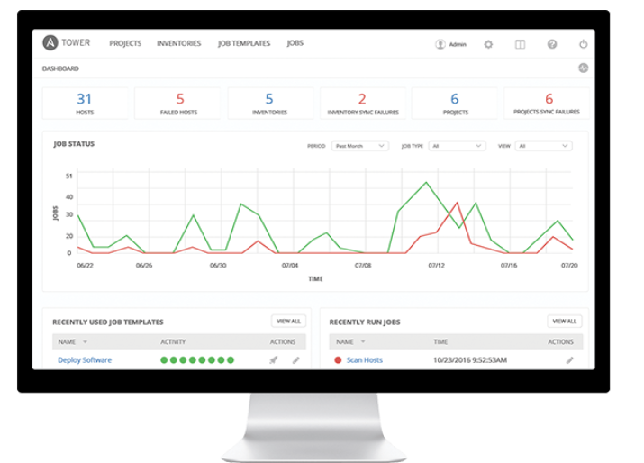
Dashboard and User Interface

Slide 52
User Base
A user is an account to access Ansible Tower and its services given the permissions granted to it.
An organization is a logical collection of users, teams, projects, inventories and more. All entities belong to an organization with the exception of users.
Teams provide a means to implement role-based access control schemes and delegate responsibilities across organizations.

Slide 53
Credentials
Credentials are utilized by Ansible Tower for authentication with various external resources:
Connecting to remote machines to run jobs
Syncing with inventory sources
Importing project content from version control systems
Connecting to and managing networking devices
Centralized management of various credentials allows end users to leverage a secret without ever exposing that secret to them.

Slide 54
Inventory
Inventory is a collection of hosts (nodes) with associated data and groupings that Ansible Tower can connect to and manage.
Hosts (nodes)
Groups
Inventory-specific data (variables)
Static or dynamic sources

Slide 55
Projects
A Project is a logical collection of Ansible Playbooks, represented in Ansible Tower.
You can manage Playbooks and Playbook directories by placing them in a source code management system supported by Ansible Tower, including Git, Subversion, and Mercurial.

Slide 56
Job Templates
A job template is a definition and set of parameters for running an Ansible Playbook. Job templates are useful to execute the same job many times and encourage the reuse of Ansible Playbook content and collaboration between teams.

Slide 57
Jobs
A job is an instance of Ansible Tower launching an Ansible Playbook against an inventory of hosts.
Job results can be easily viewed
View the standard out for a more in-depth look

Slide 58
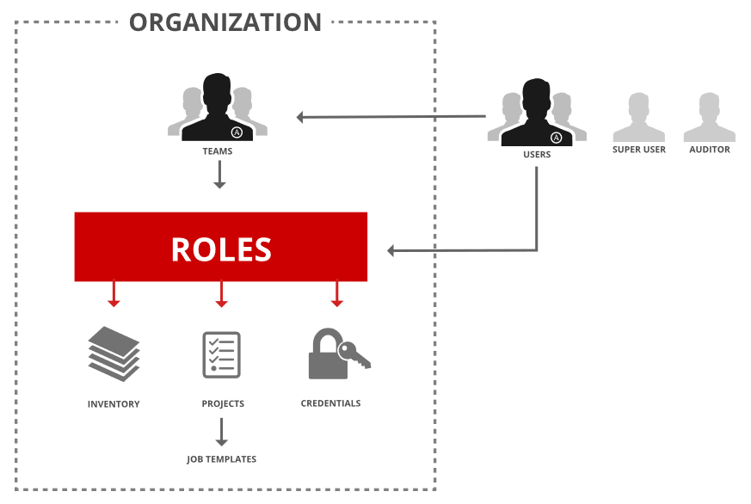
Role Based Access Control (RBAC)
Role-Based Access Controls (RBAC) are built into Ansible Tower and allow administrators to delegate access to server inventories, organizations, and more. These controls allow Ansible Tower to help you increase security and streamline management of your Ansible automation.

Slide 59
Lab : Configuring Ansible Tower

Slide 60
Dynamic Inventory in Ansible Tower
Dynamic inventory is a script that queries a service, like a cloud provider API or a management application. This data is formatted in an Ansible-specific JSON data structure and is used in lieu of static inventory files.
Groups are generated based on host metadata
Single source of truth saves time, avoids duplication and reduces human error
Dynamic and static inventory sources can be used together

Slide 61
More with Ansible Tower
Job Status Updates
Activity Stream
Integrated Notifications
Schedule Jobs
Manage and Track Your Inventory
Self Service IT (User Surveys)
Remote Command Execution
External Logging
Multi-Playbook Workflows

Slide 62
Next Steps
It’s easy to get started ansible.com/get-started
Try Ansible Tower for free: ansible.com/tower-trial
Would you like to learn a lot more? redhat.com/en/services/training/do409-automation-ansible-ii-ansible-tower

Slide 63
Lab : Creating and Running
Job Template

Slide 64
THANK YOU
plus.google.com/+RedHat
facebook.com/redhatinc
linkedin.com/company/red-hat
twitter.com/RedHatNews
youtube.com/user/RedHatVideos

Slide 65
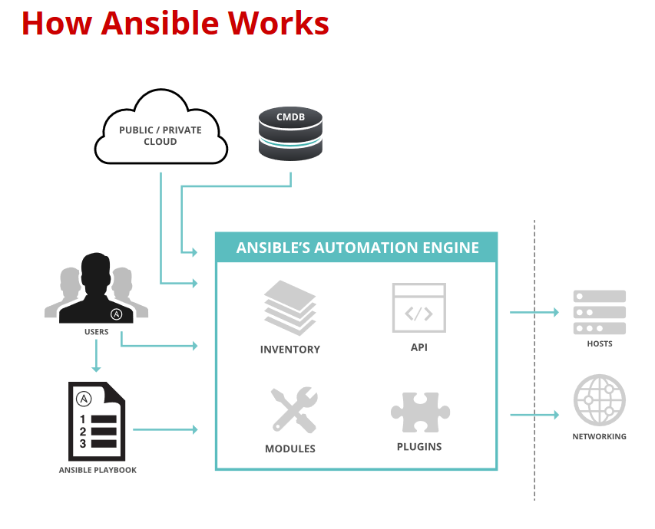

Slide 66
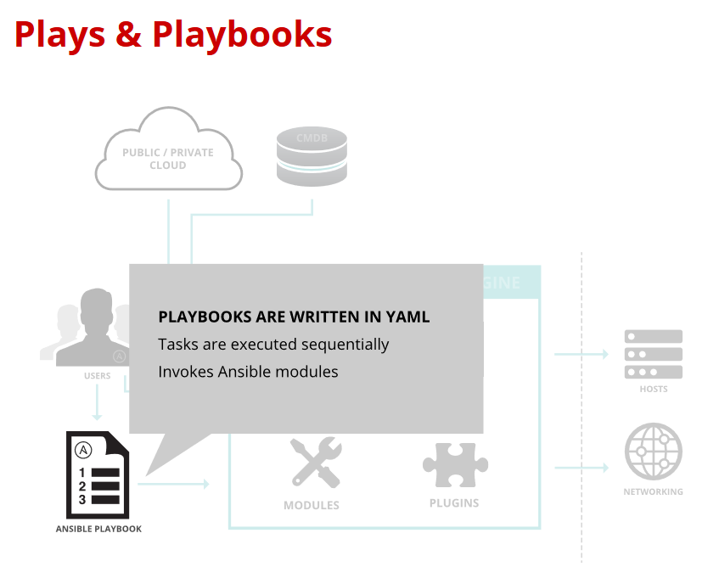

Slide 67
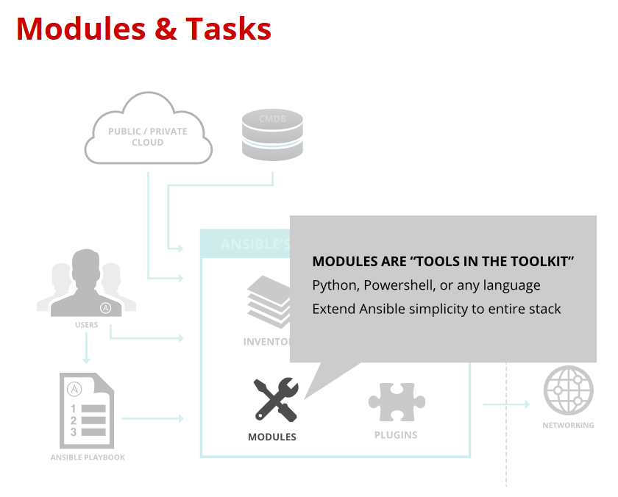

Slide 68
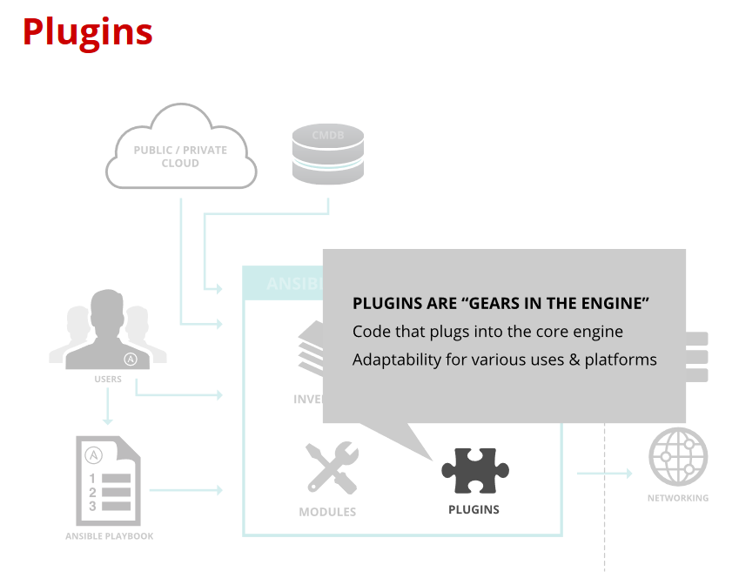

Slide 69
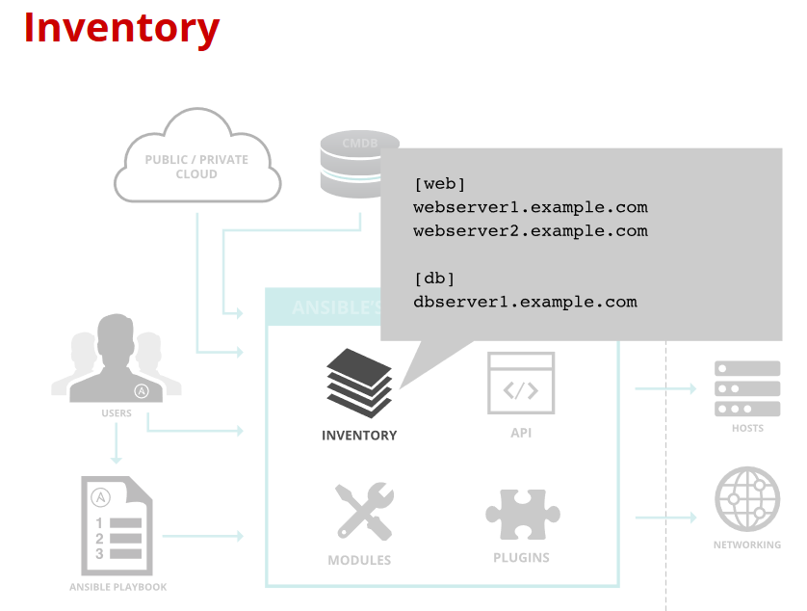

Slide 70
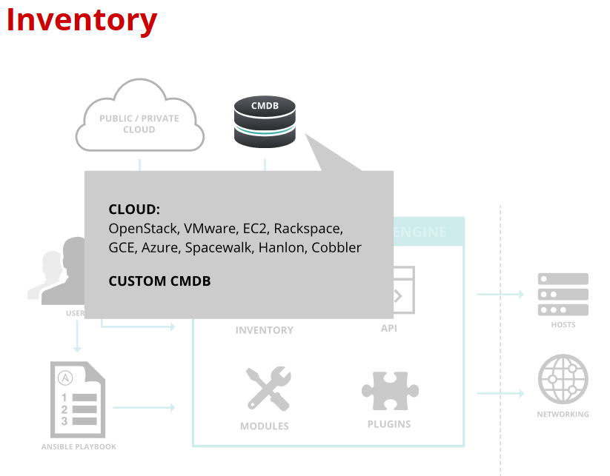

Slide 71
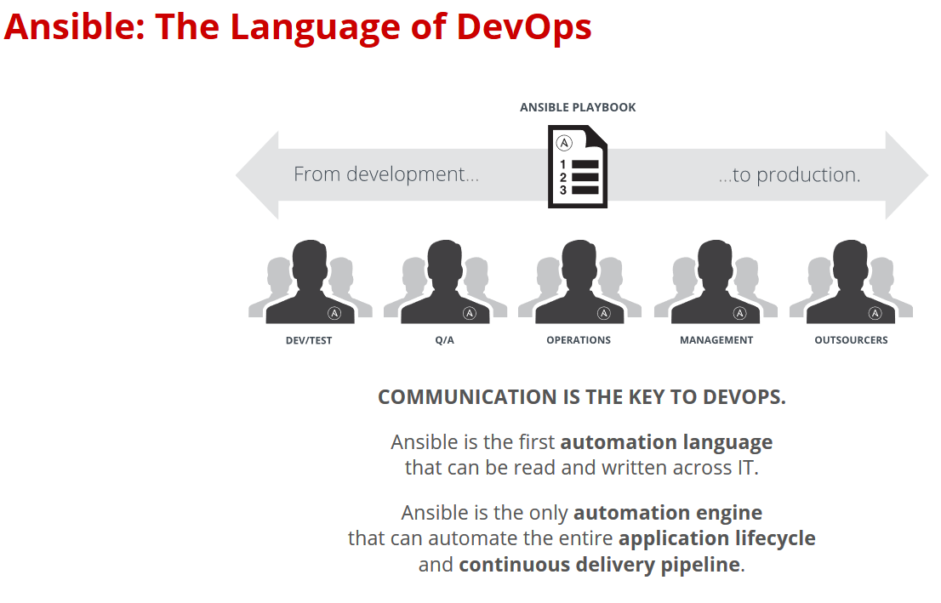

Slide 72
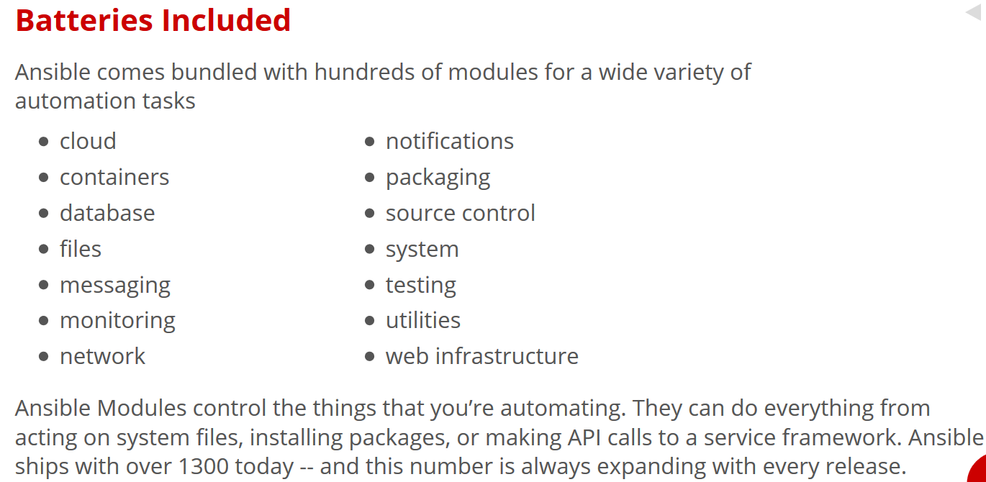

Slide 73
